Slide 1
Approximation Algorithms

Slide 2
Approximation Algorithms
If a problem is NP-complete, we are unlikely to find a polynomial-time algorithm for solving it exactly, but even so, there may be hope.
There are at least three approaches to getting around NP-completeness.
First, if the actual inputs are small, an algorithm with exponential running time may be perfectly satisfactory.
Second, we may be able to isolate important special cases that are solvable in polynomial time.
Third, it may still be possible to find near-optimal solutions in polynomial time (either in the worst case or on average).
In practice, near-optimality is often good enough. An algorithm that returns near-optimal solutions is called an approximation algorithm.

Slide 3
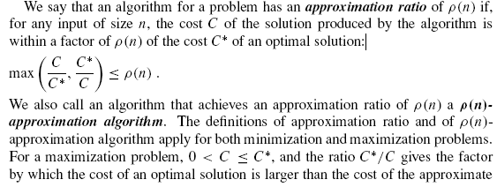
Performance ratios for approximation algorithms

Slide 4
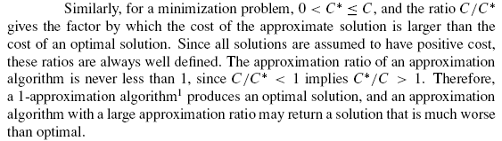
Performance ratios for approximation algorithms

Slide 5

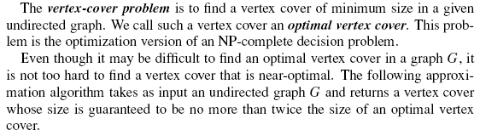
The vertex-cover problem

Slide 6
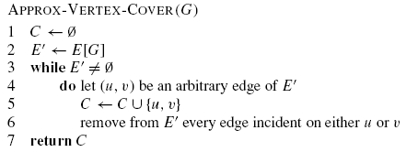
APPROX-VERTEX-COVER
Complexity:?

Slide 7
APPROX-VERTEX-COVER
The running time of above algorithm is O(V + E), using adjacency lists to represent E.

Slide 8
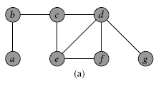
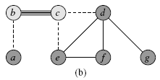
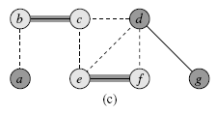
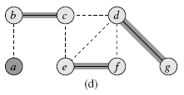
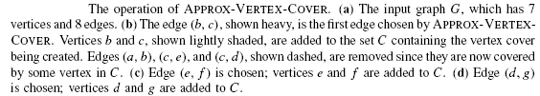
APPROX-VERTEX-COVER: Example

Slide 9
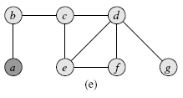
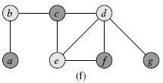
APPROX-VERTEX-COVER: Example…

